Slide 1


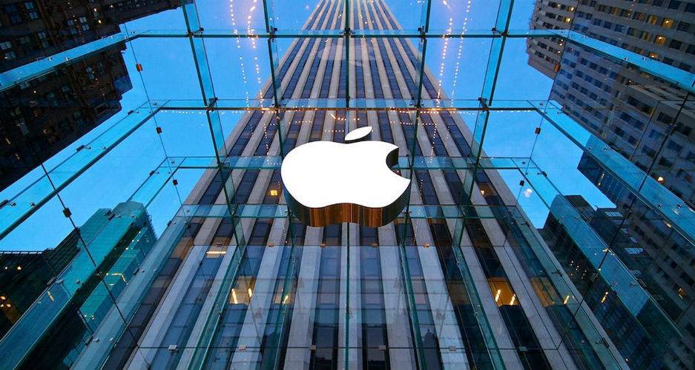
COMPREHENSIVE ANALYSIS OF APPLE INC.’S STOCK MARKET DATA
Notes:
Welcome, everyone, to our presentation titled 'In-Depth Analysis of Apple Inc.'s Stock Market Data.' Over the next few minutes, we will present significant findings stemming from extensive centuries-spanning data analysis. We invite you to join us as we reveal the narrative behind Apple's stock performance and its impact on the financial landscape

Slide 2






MEET
THE TEAM
Obinna N.
Sandisiwe
Luhle
Chikezie
Obinna E.
Joy
Notes:
Meet our team which consists of both data scientists and data engineers.

Slide 3

EXECUTIVE SUMMARY
Significance
Critical for investors and analysts making informed decisions
Notes:
In the ever-changing world of finance, it's crucial for investors and analysts to really understand how well Apple Inc.'s stock is doing. That's where our project, the Comprehensive Analysis of Apple Inc.'s Stock Market Data, comes in. We're taking a close look at a big dataset from the past to find hidden patterns and important information.
We sourced our data from various reliable sources, such as Kaggle and Yahoo Finance, spanning from the year 1085 up to July 2023. This extensive dataset enabled us to delve deep into the dynamics of extreme price movements within the market. Our analysis unveiled critical insights, ultimately positioning Apple as the frontrunner in terms of both revenue generation and growth rate when compared to its competitors

Slide 4
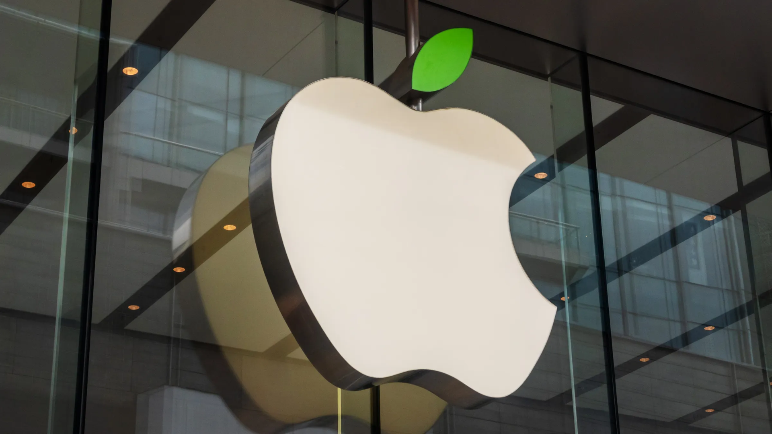
CONTENTS
EDA OF AAPL STOCK DATA
INDUSTRY COMPARABILITY
RECOMMENDATIONS
CONCLUSION
Notes:
Let's navigate through our presentation, where we'll start with an Exploratory Data Analysis (EDA) of Apple's stock data, then move on to industry comparability, explore our recommendations, and conclude with the key takeaways from our comprehensive analysis.

Slide 5
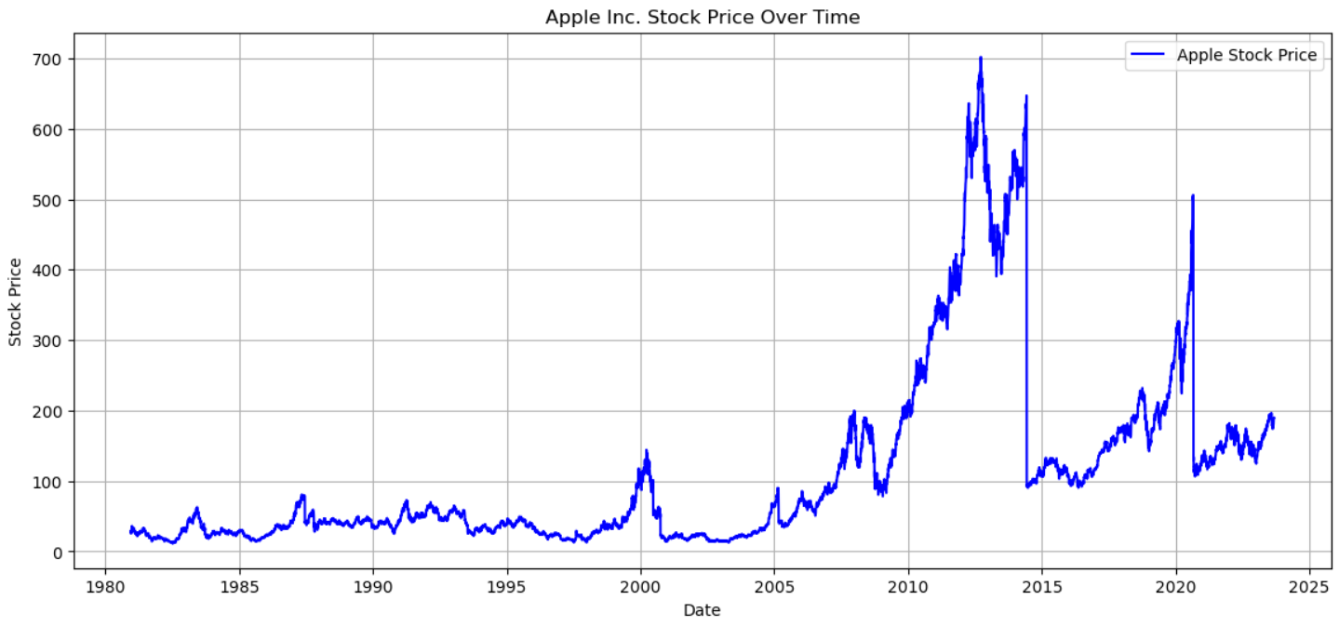
EDA OF AAPL STOCK DATA
Time Series Analysis
Notes:
The Apple Inc. stock price has shown steady growth since 1980's, offering long-term investors substantial returns. Between 2010 and 2015, there was an impressive surge, with the stock price increasing by over $700, benefiting early investors. However, periodic fluctuations are evident, reflecting typical market dynamics influenced by factors like market sentiment and economic conditions. In 2020, the stock exhibited significant volatility, possibly due to the COVID-19 pandemic's impact. Notably, from 2020 to 2023, a downward trend was observed, which could be attributed to changes in the competitive landscape, economic conditions, or investor sentiment.

Slide 6
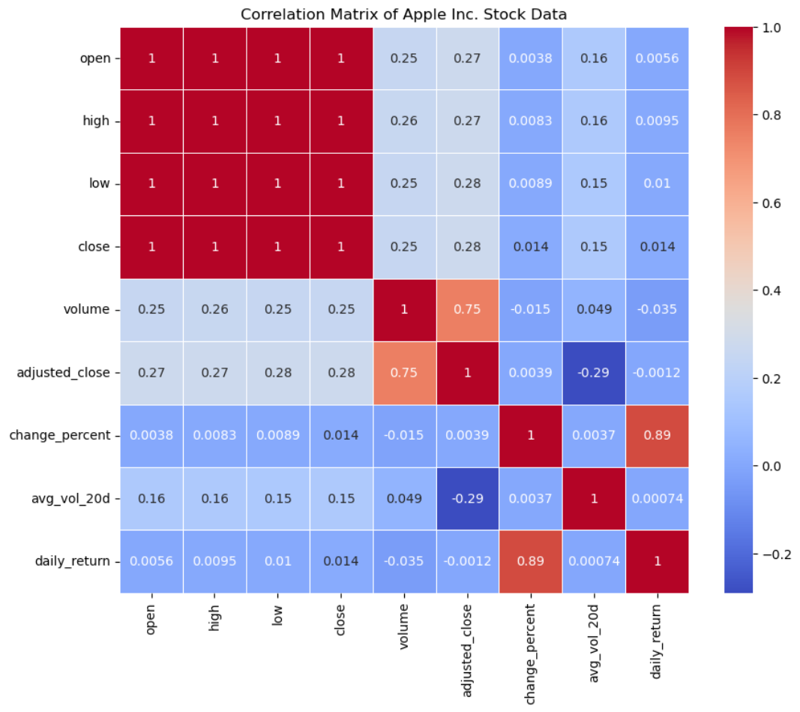
EXPLORATORY DATA ANALYSIS
Relationship
Price and Volume
Adjusted close and Voulme
Notes:
· The moderate positive correlation between volume and stock prices suggests that there is some degree of synchrony between trading volume and price movements. When the stock is actively traded, it tends to experience price changes.
· The strong positive correlation between adjusted_close and volume suggests that periods of high trading volume often coincide with significant price movements. This relationship can be useful for analyzing market dynamics.

Slide 7
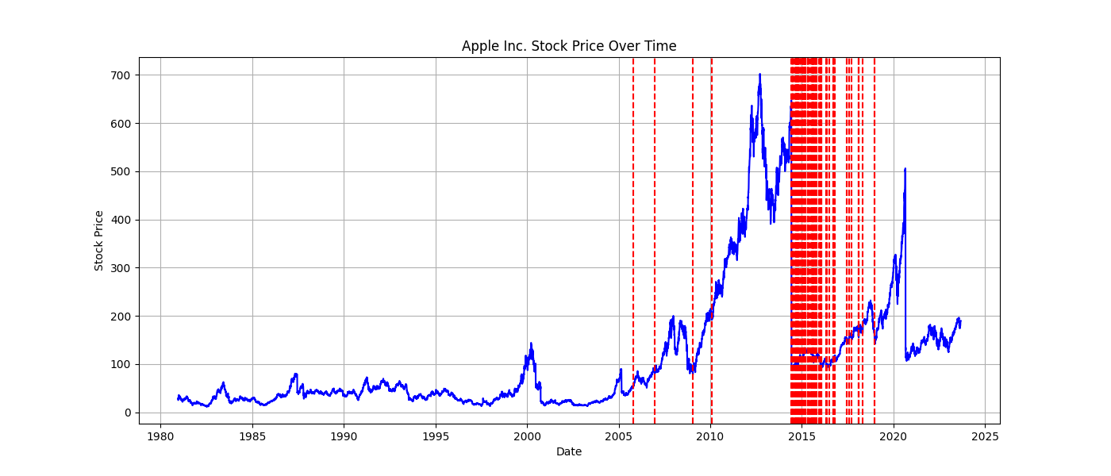
EXPLORATORY DATA ANALYSIS
Effect of volume on stock price
+ Sentiment analysis

Slide 8
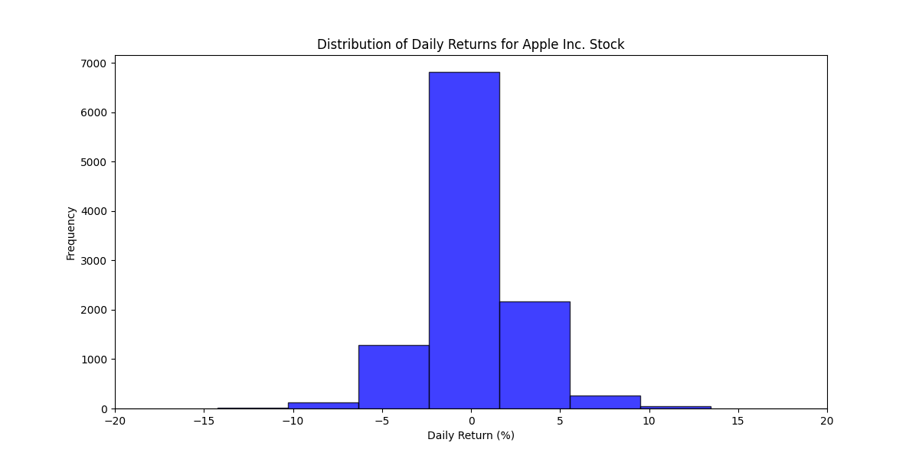
EXPLORATORY DATA ANALYSIS
Stock Character
Stable price
Notes:
The histogram of daily returns indicates that most daily returns are clustered around zero, suggesting relatively stable daily price movements
## stock value stability and low risk indicator.

Slide 9
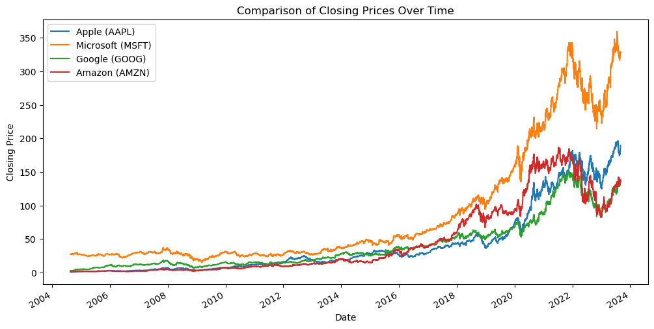



INDUSTRY COMPARABILTIY
Stock Trend Anaysis
Notes:
In addition, we sourced data for other prominent technology companies from Yahoo Finance to conduct an industry comparability analysis. It's noteworthy that each of these companies exhibits a distinct range of stock prices, characterized by varying degrees of volatility.
While the average stock prices within this dataset exhibit considerable diversity, it is pertinent to observe that, as a general trend, they demonstrate an upward trajectory over the course of time.

Slide 10
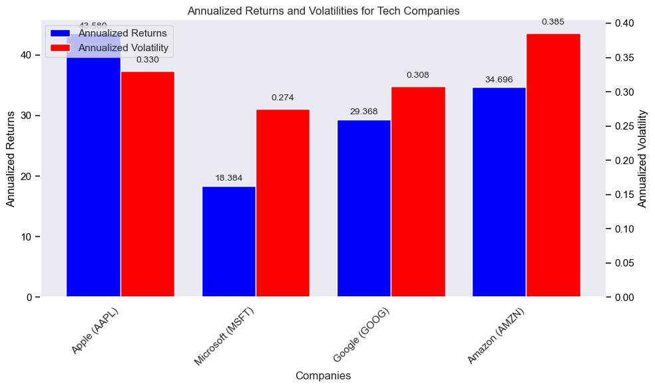
INDUSTRY COMPARABILTIY
Stock Annaual Returns & Risk
Notes:
Annualized Returns:
Apple (AAPL) has an annualized return of approximately 43.58%.
When compared to the other three stocks, Apple has the highest annualized return. This suggests that, in terms of returns, Apple has been a strong performer among these tech giants.
Volatility:
Apple (AAPL) shows an annualized volatility of around 33.00%. This reflects its price fluctuation risk, which falls between Microsoft (MSFT) and Google (GOOG) but is lower than Amazon (AMZN), potentially appealing to more stability-focused investors.

Slide 11
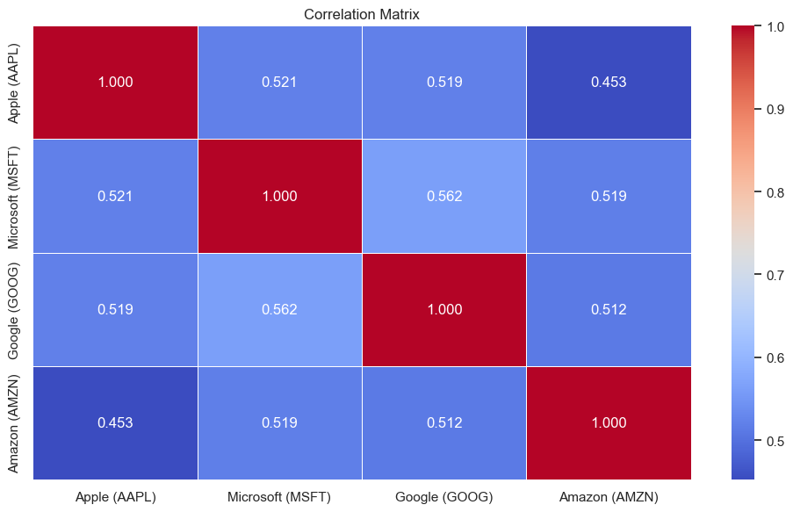
INDUSTRY COMPARABILTIY
Stock price correlation
Notes:
Apple (AAPL) shows positive correlations with all three stocks: Microsoft (MSFT), Google (GOOG), and Amazon (AMZN).
These positive correlations suggest that Apple's returns generally move in tandem with those of other tech stocks. However, they aren't exceptionally high, indicating a degree of independence in their performance.

Slide 12


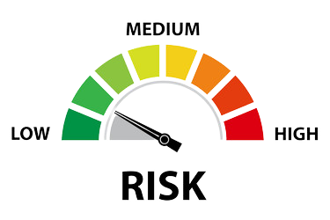

RECOMMENDATION
PORTFOLIO
DIVERSIFICATION
STRONG RETURNS
Notes:
Strong Returns: Apple shines with robust annualized returns, surpassing the other tech giants, making it appealing to growth-oriented investors.
Moderate Volatility: Apple maintains moderate volatility, offering relatively stable price movements compared to Amazon's higher volatility.
Portfolio Diversification: Positive correlations between Apple, Microsoft, Google, and Amazon imply common market trends. Diversifying within the tech sector may not provide significant benefits due to their shared positive relationships.

Slide 13

CONCLUSION
INVESTMENT STRATEGY
UNDERSTAND POTENTIAL RISKS
Notes:
After conducting a comprehensive Exploratory Data Analysis (EDA) of Apple's historical stock market data, several key insights have been uncovered. These insights provide valuable information for investors and stakeholders seeking to understand the historical performance of Apple stock and make informed decisions.
In conclusion, Apple Inc.'s stock presents opportunities for investors, but it's essential to approach it with a clear investment strategy and an understanding of the potential risks involved. Historical data provides valuable insights, but future performance depends on various factors, including market conditions and company developments.
So investors are advised to make investment decisions that align with your financial goals and risk tolerance.

Slide 14


QUESTIONS

